Slide 1

Week01: Xcode & Swift Basics
In the AI Era(Swift + SwiftUI)
Instructor : Mr. Nem Sothea
nemsothea13@gmail.com

Slide 2
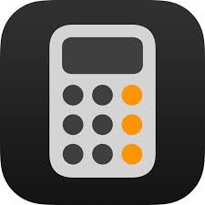
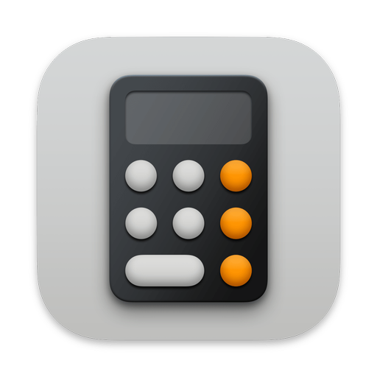

What We're Building Towards
Example app :
The Goal: To build your own iOS apps and publish them on the App Store.
The Path:
  Learn the language: Swift.
  Learn the tools: Xcode.
  Learn the framework: UIKit & SwiftUI.

Slide 3

Prerequisites:
Basic programming knowledge:
MacOS computer for Xcode development
iPhone or iPad for testing (simulator available)
Having an Apple ID is recommended.

Slide 4
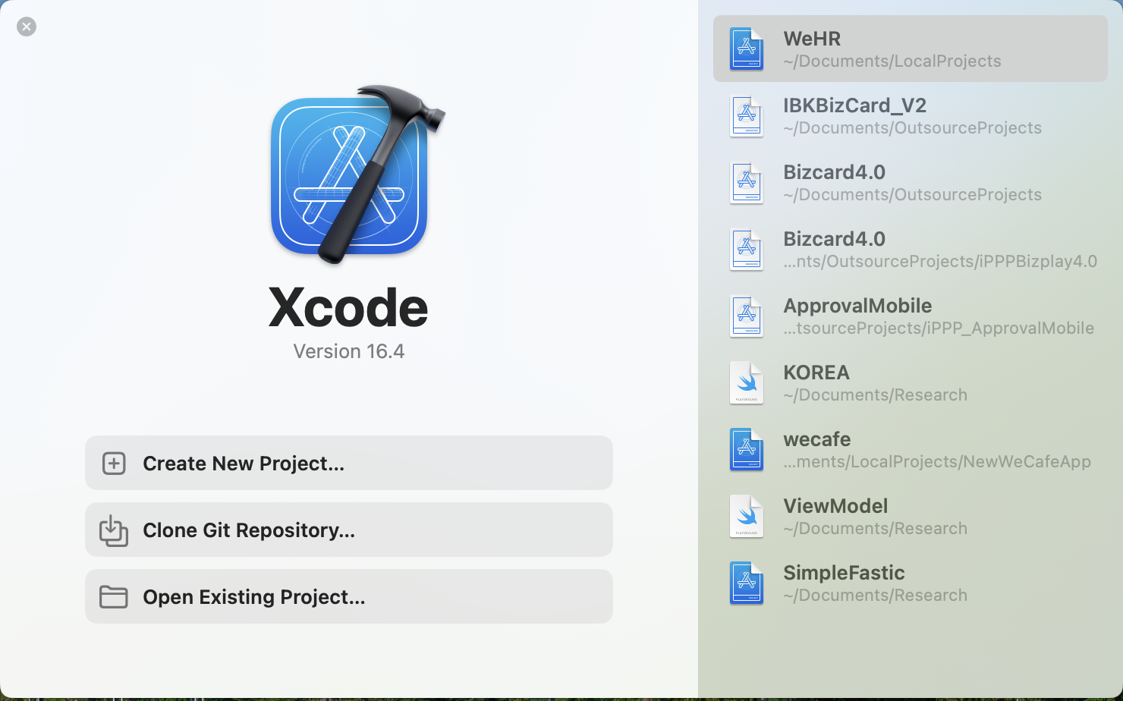
What is Xcode?
Xcode is... Apple's Integrated Development Environment (IDE).
It's your workshop: Everything you need to build apps for Apple platforms (iPhone, iPad, Mac, Apple Watch, Apple TV).
It includes:
  A code editor
  A visual UI editor (Storyboards & SwiftUI Canvas)
  A debugger
  The iOS Simulator
  And much more!

Slide 5
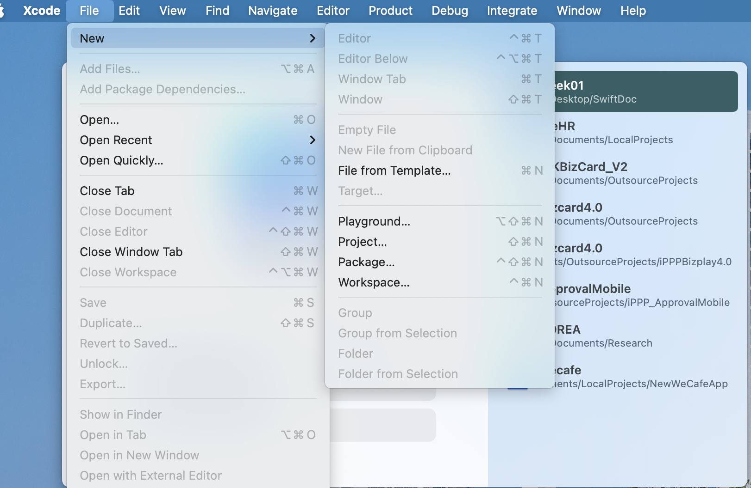
Create Your First Playground
Playgrounds are perfect for learning Swift.
They let you write code and see the results immediately, without building a full app.
Let's open Xcode:
  "Get started with a playground"
  Choose "iOS" -> "Blank" template.
  Name it "Week01.playground".

Slide 6
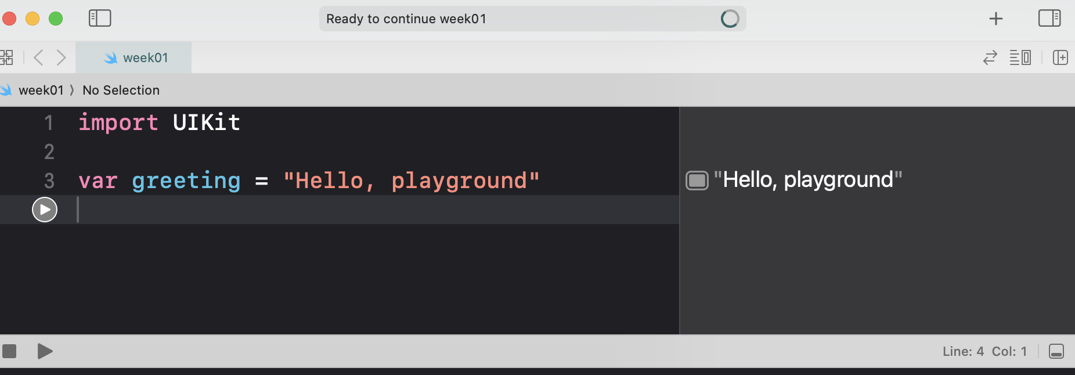
The Playground Interface - Live Demo
Code Editor (Left): Where you write your Swift code.
Results Sidebar (Right): Shows the output of each line of code.
Run Button: Click to execute your code.
Let's open Xcode and do this together!

Slide 7
The Swift Language
Swift was created by Chris Lattner for Apple in 2010, with the language first introduced at WWDC 2014. While Apple is responsible for its development, the language is now maintained by the open-source community through. Swift.org
Swift is... a powerful and intuitive programming language created by Apple.
It is: Modern, safe, fast, and easy to read.
Key Concept: Swift is strongly typed and uses type inference. This means it's very careful about what kind of data (text, number, etc.) you're working with.
Swift has undergone significant versions since its 1.0 release in 2014, with major versions including Swift 1, 2, 3, 4, and 5, followed by the recently released Swift 6 in 2024, each bringing new features and stability improvements. Key milestones include Swift 2.0 in 2015, Swift 3.0 in 2016, Swift 4.0 in 2017, and Swift 5 in 2019, which introduced a stable binary interface on Apple platforms. The most recent version, Swift 6.0, was released in 2024, and further development continues with Swift 6.2 released in 2025.

Slide 8
Storing Data - Variables & Constants
We store data in variables (can change) and constants (cannot change).
Use var for variables.
Use let for constants. (Prefer let whenever possible!)
// This is a comment. The computer ignores it.
// A variable: its value can vary.
var myName = "Pisey"
myName = "Pisey Jo"// This is allowed.
// A constant: its value is constant.
let birthYear = 2000
// birthYear = 2001 // This would cause an ERROR!

Slide 9
Data Types
Swift has many built-in types. The compiler infers the type from the value you assign.
String: Text, surrounded by double quotes. "Hello"
Int: Whole numbers. 42, -7
Double: Decimal numbers. 3.14159
Bool: true or false
let message: String = "Hello World"// Explicit type annotation
let score = 1000 // Inferred as Int
let pi = 3.14 // Inferred as Double
let isLoggedIn = true // Inferred as Bool

Slide 10
Operators
Assignment: = (Assigns a value)
Arithmetic: +, -, *, /
Compound Assignment: +=, -=
Comparison: == (equal to), != (not equal to), >, <, >=, <=
let a = 10
let b = 3
let sum = a + b// 13
let isGreater = a > b// true
var counter = 0
counter += 1// counter is now 1

Slide 11
Control Flow - Making Decisions
let temperature = 70
if temperature > 80 {
print("It's hot outside!") // This won't run
} else if temperature > 60 {
print("It's nice outside!") // This WILL run
} else {
print("It's a bit chilly.")
}
Use if, else if, and else statements to run code based on conditions.

Slide 12
In-Class Exercise 1
Let's code together in our Playground!
  Create a constant name and a variable age.
  Assign them values.
  Print a message that says: "[name] is [age] years old."
  Write an if statement that checks if the person can vote (age >= 18) and prints "Can vote" or "Can't vote".

Slide 13
Solution to Exercise 1
let name = "Borey"
var age = 27
print("\(name) is \(age) years old.")
// This is called string interpolation. It lets you put variables inside strings.
if age >= 18 {
print("Can vote")
} else {
print("Can't vote")
}

Slide 14
What's Next? UIKit vs. SwiftUI
UIKit (The Original Way): Uses Storyboards and ViewControllers. More code, but shows you how everything works.
SwiftUI (The New Way): Write what you want the UI to look like. Less code, very powerful.
Our Plan: We'll learn the basics of UIKit first to understand the fundamentals, then switch to the modern SwiftUI.

Slide 15
Homework Assignment
Goal: Get comfortable with the basics.
Task 1: In your Playground, create variables for a made-up character (name, age, home planet, favorite color).
Task 2: Use string interpolation to print a paragraph describing them.
Task 3: Use an if statement to check if their age is over 500 and print "This character is ancient!" or "This character is young.".
Bonus: Use a Bool variable isJedi and add to your if statement to print "This character is a powerful Jedi" if they are both ancient and a Jedi.
** Kindly create GitHub repositories for this assignment and send me the links via email.

Slide 16
Questions?
Next Week: Collections (Arrays & Dictionaries) and Loops!
Thank you!

